Slide 1
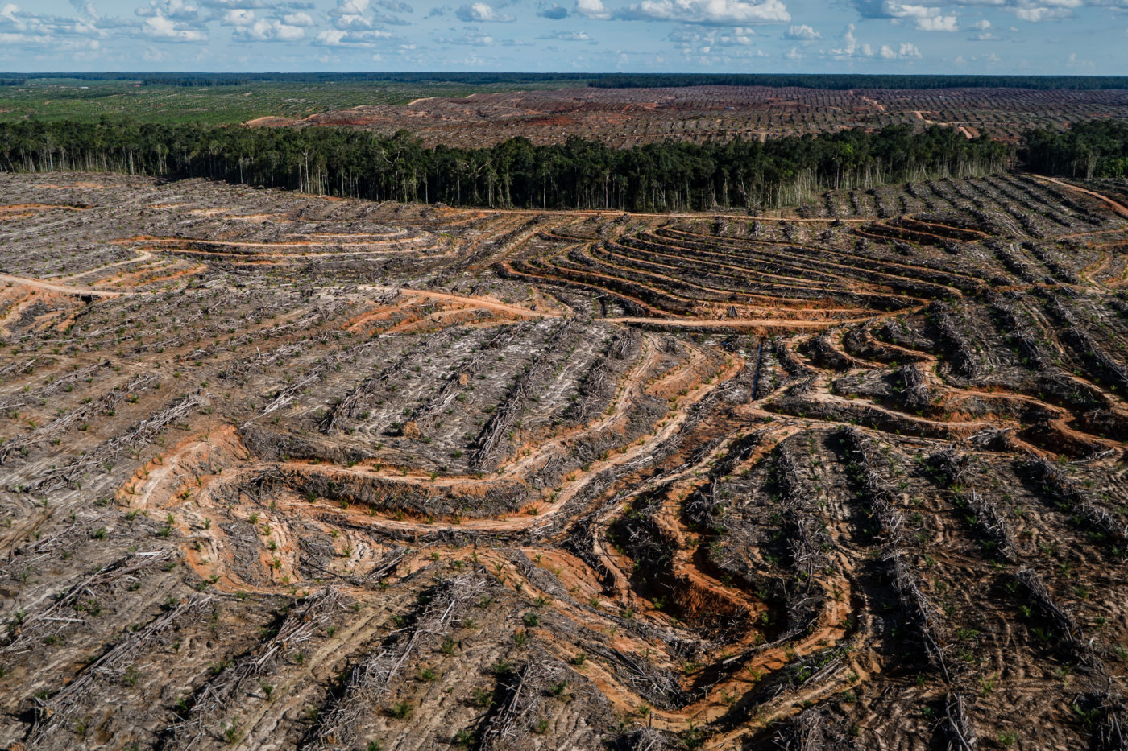
On-going trends in timber trade requirements and regulations
Rupert Oliver
Global Legal and Sustainable Timber Forum
Session 1: Restoring Reliable and Stable Supply of Timber Resource
11 September 2024

Slide 2
CITES
Logging bans in natural forest
Log export bans & other trade restrictions
FLEG incentive measures & illegal wood trade prohibitions
Circular economy
Voluntary timber certification
Procurement policies
Urbanisation and green building

Slide 3
"Fourth Industrial Revolution"
Rapidly improving access to regularly updated and high-resolution remote sensing data
Development of AI
Blockchain in supply chain management
Timber testing to identify provenance (SIRA, TEA, LIBS handheld)
Hyper-Connectivity - advances in 5G etc
Social media
From Lesiv et al, 2022, Global forest management data for 2015 at 100 m resolution

Slide 4
Some implications of emerging technologies
Potential to provide absolute proof of deforestation-free status at point of sale
“Deforestation-free” may overtake “certified sustainable” & “legally-verified”
Greatly facilitates jurisdictional & landscape-based verification
Rapid robust appraisal of changes in forest and other land-uses
Clear attribution of deforestation to specific drivers and actors
Efficient data gathering on legal conformance & social/environmental impacts
Better targeting of mitigation action
More efficient & regular outreach and feedback from stakeholders
Different/conflicting models to prove timber provenance:
100% tracking to specific harvest sites throughout entire supply chain using blockchain – very robust and demands participation of all supply chain actors, may be challenging for smallholders and SMEs
Regular SIRA/TEA/LIBS testing of a random sample of timber products at point of sale to ensure provenance to jurisdictions with a negligible risk of deforestation and illegal harvest – may allow for more flexible CoC custody procedures and more applicable by smallholders and SMEs
A suite of new innovative regulatory tools is required

Slide 5
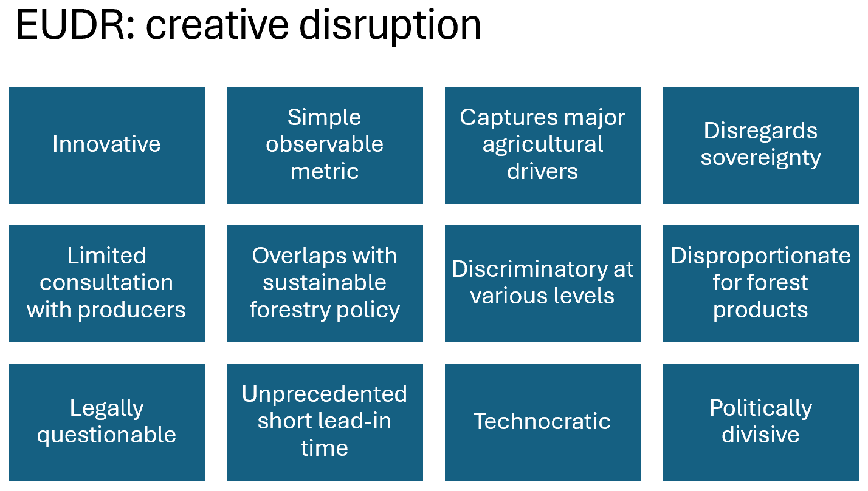
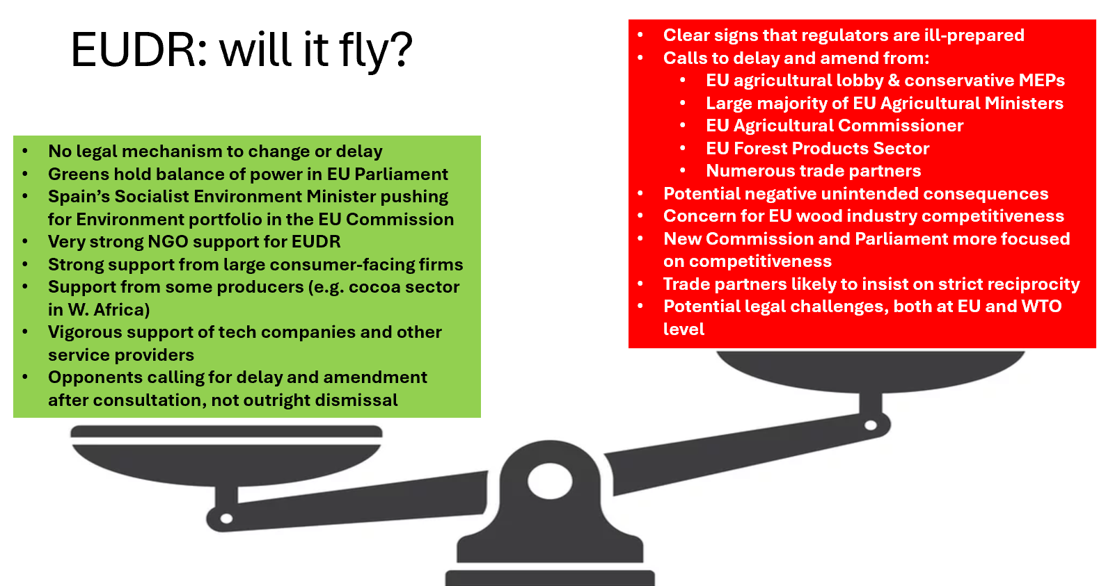
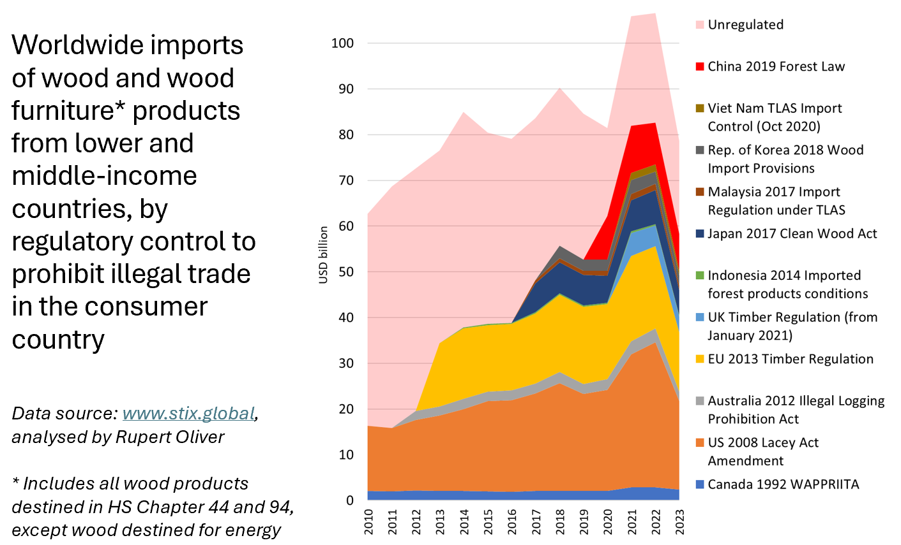
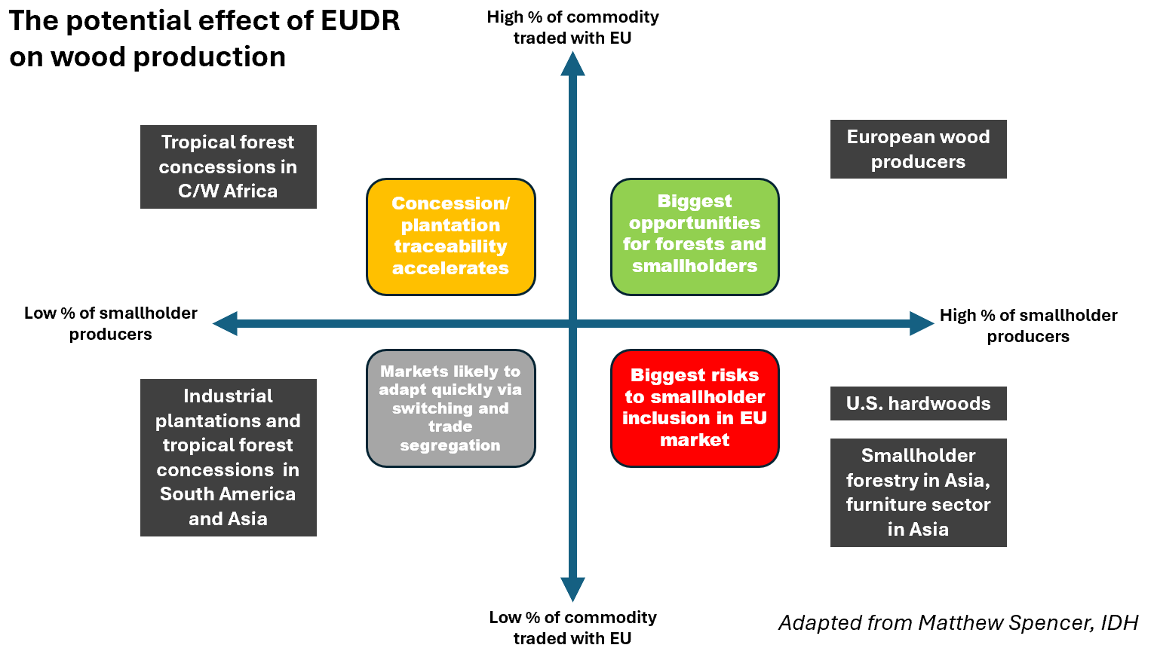

Slide 6
Pointers to successful regulatory framework
Extend to all forest-risk commodities
Do not lose focus on governance and legality
Maximise use of new technology but moderate expectations
Robust objective risk assessment is a prerequisite
Accommodate jurisdictional & landscape-based approaches to verification
Traceability to the extent necessary to demonstrate negligible risk
Appropriate lead-in times
Far-reaching & appropriate social protection measures
Consultation, engagement and partnership with producers
Work on international & cross-sectoral co-ordination

Slide 7
Thank you!
Rupert Oliver
Global Legal and Sustainable Timber Forum
Session 1: Restoring Reliable and Stable Supply of Timber Resource
11 September 2024

Slide 9
FSC and PEFC certified forest area, 2000 to 2023
Data sources:
https://connect.fsc.org/impact/facts-figures
https://pefc.org/discover-pefc/facts-and-figures
Analysed by Rupert Oliver
* Dual are forest areas certified to both standards. Dual certified area prior to 2016 is estimated by Rupert Oliver

Slide 10
Worldwide imports of wood and wood furniture* products from lower and middle-income countries, by regulatory control to prohibit illegal timber trade in the consumer country
Data source: www.stix.global, analysed by Rupert Oliver
* Includes all wood products destined in HS Chapter 44 and 94, except wood destined for energy

